Slide 1
Graph: Strongly Connected Component
Session 16
Henry Lucky, S.Kom. M.Kom.

Slide 2
Outline Materials
Session 19
Strongly connected definition
Tarjan's SCC algorithm

Slide 3
Learning outcomes
LO 1: Explain fundamental concept of analysis algorithms
LO 2: Apply algorithm techniques and methods
LO 3: Solve a problem using specific algorithm.
LO 4: Compare several algorithm design methods

Slide 4
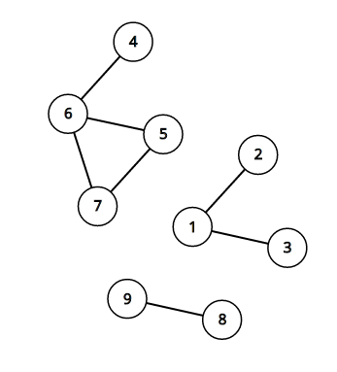
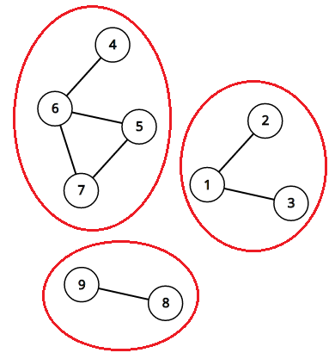
Strongly connected definition
Connected Components
An undirected graph can be partitioned into several connected components
A connected component is a maximal subset of the vertices such that each pair of vertices is reachable from each other
An undirected graph with 3 connected components

Slide 5
Strongly connected definition
Connected Components
We can find these components using depth-first search / breadth-first search
Pick some vertex that we don’t know anything about and do a depth-first or bread-first search out from it.
All vertices that can be reached from that starting vertex belong to the same component
Repeat this process for the remaining unvisited vertices until all vertices are visited and you will have all the components from that graph.
Time complexity is O( V+E ), where V is the number of vertices and E is the number of edges.

Slide 6


Strongly Connected Definition
Original DFS Procedure
INIT(G)
1 for each vertex $u∈G.V$
2 $u.visited=FALSE$
3 for each vertex $u∈G.V$
4 if $u.visited==FALSE$
5 DFS(G, u)
DFS(G, u)
1 if $u.visited==TRUE$
2 return
3 $u.visited=TRUE$
4 for each $v∈G.Adj[u]$
5 if $v.visited==FALSE$
6 DFS(G, v)

Slide 7
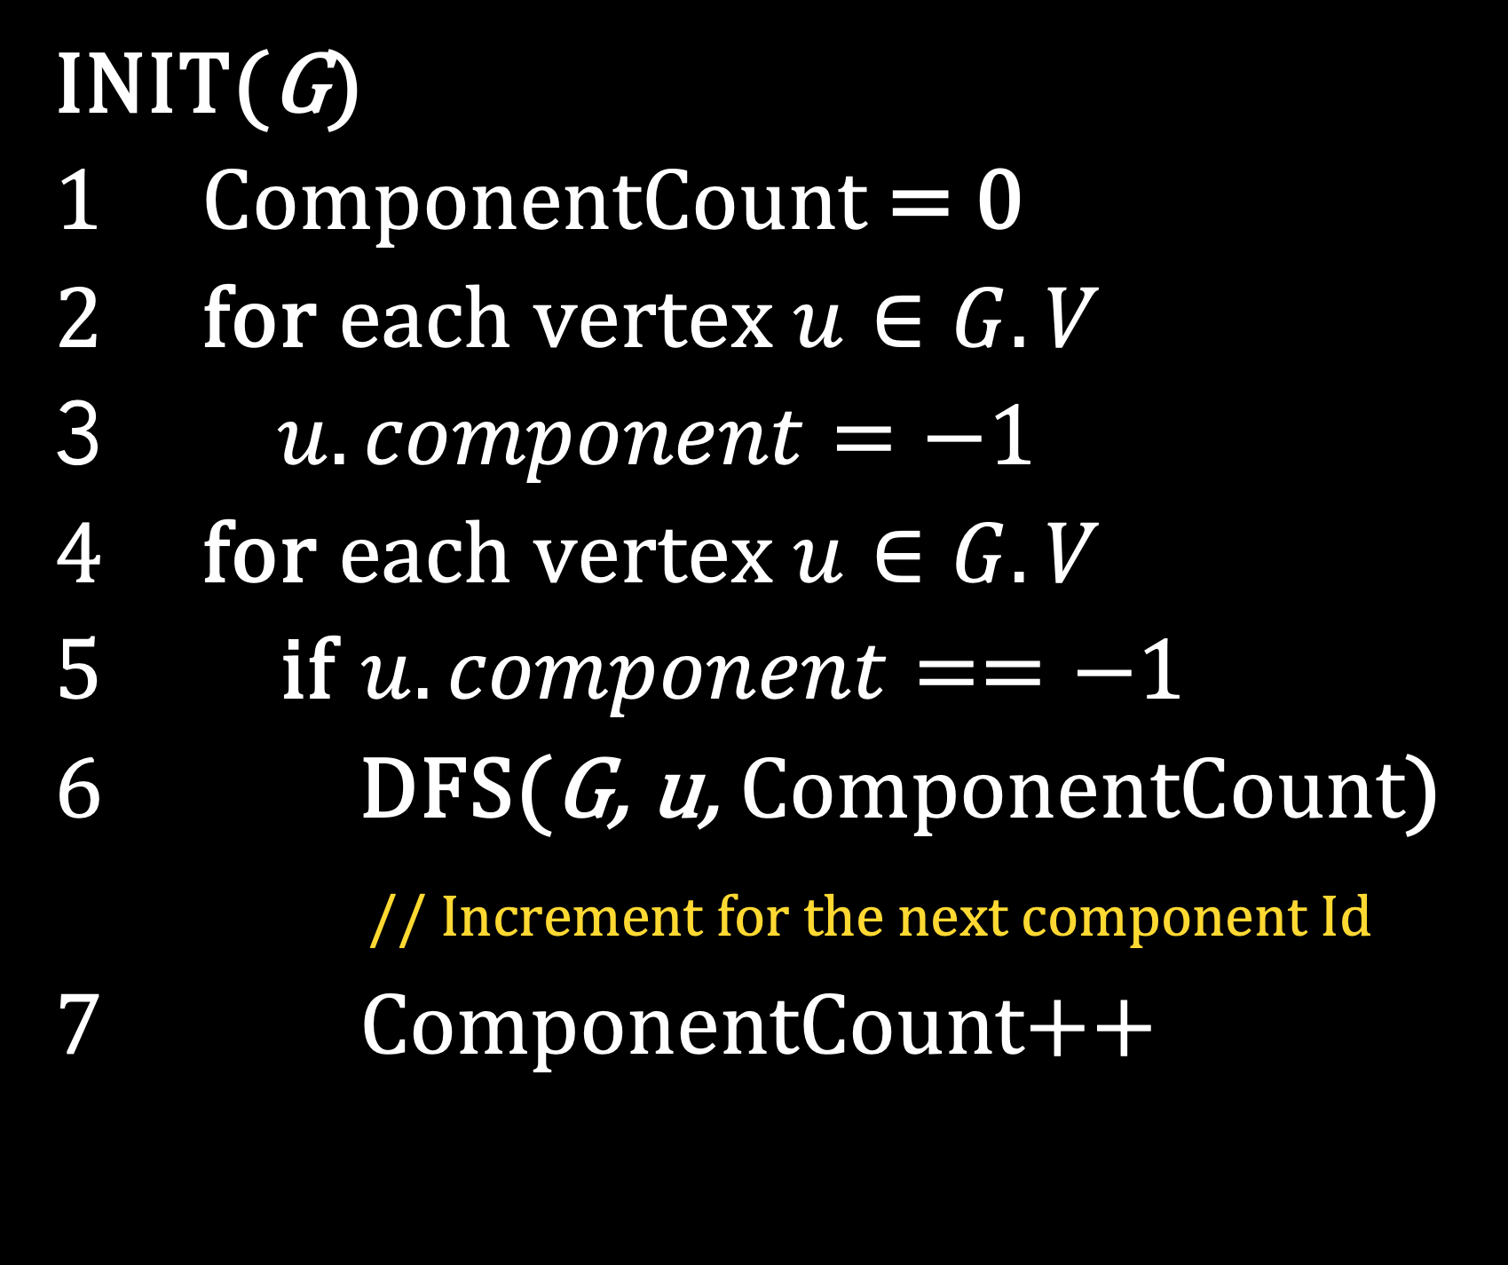
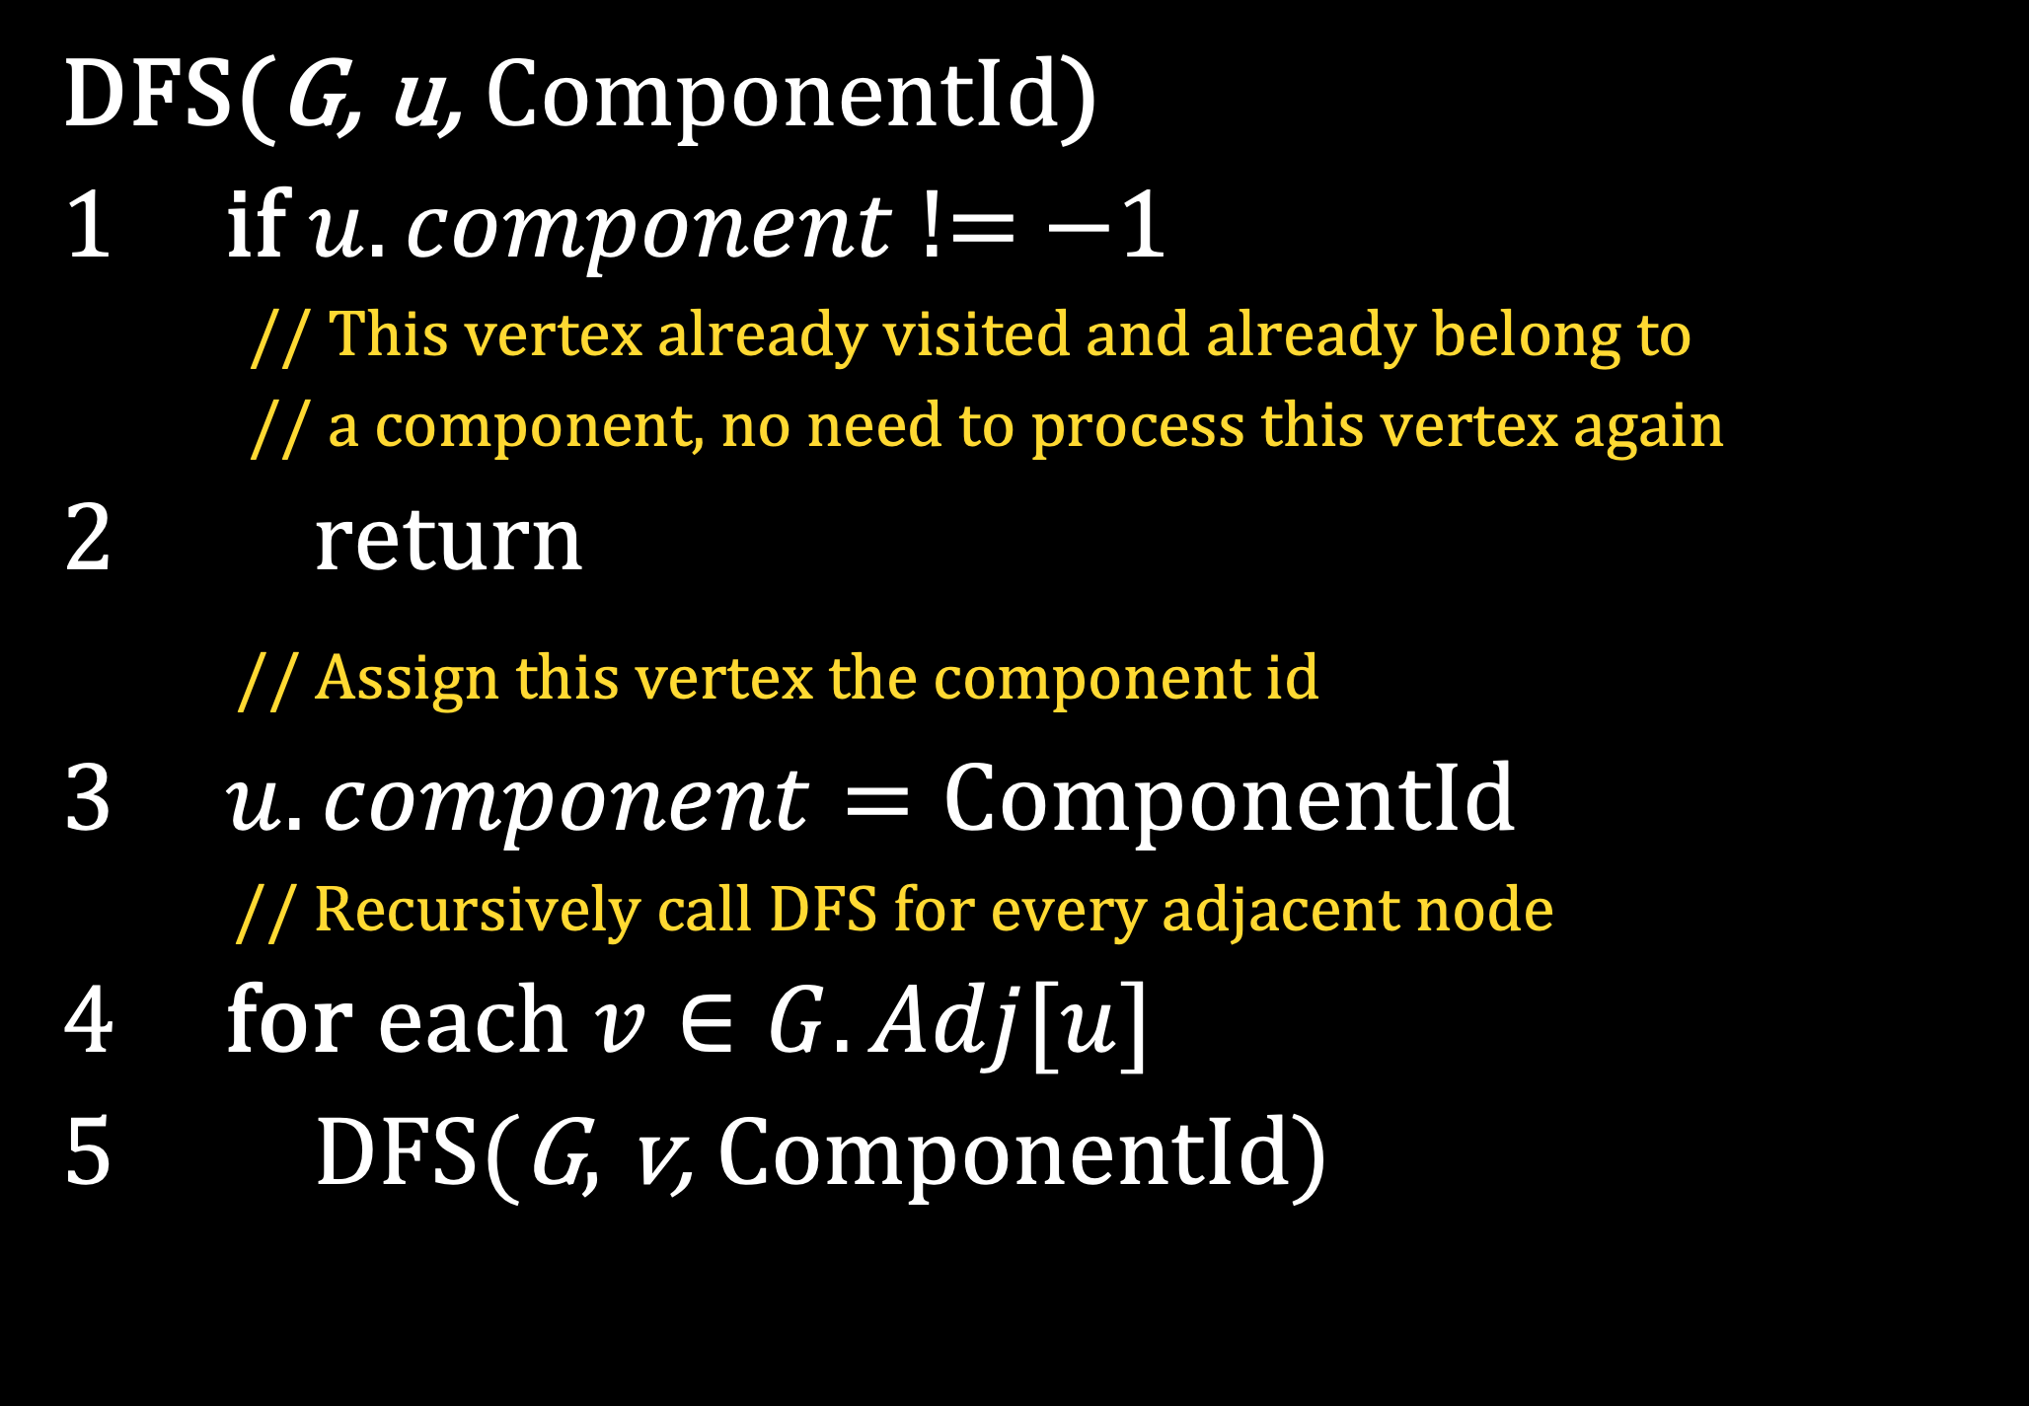
Strongly Connected Definition
DFS to find Connected components
INIT(G)
1 ComponentCount = 0
2 for each vertex $u∈G.V$
3 $u.component=−1$
4 for each vertex $u∈G.V$
5 if $u.component==−1$
6 DFS(G, u, ComponentCount)
// Increment for the next component Id
7 ComponentCount++
DFS(G, u, ComponentId)
1 if $u.component$ != $−1$
// This vertex already visited and already belong to
// a component, no need to process this vertex again
2 return
// Assign this vertex the component id
3 $u.component=\text{ComponentId}$
// Recursively call DFS for every adjacent node
4 for each $v∈G.Adj[u]$
5 DFS(G, v, ComponentId)

Slide 8
Strongly Connected Definition
Strongly Connected Components
We know how to find connected components in undirected graphs
How about directed graph?
Components behave differently in directed graphs. Because if v can be reached by u, it doesn’t mean that u can be reached by v.
The definition of “Strongly Connected Components” (SCC) is the same as “Connected Components” for undirected graph.
A strongly connected component is a maximal set of the vertices such that for every pair of the vertices in that component is reachable from each other.
The connected component algorithm (normal DFS-like) won’t work for this problem.

Slide 9
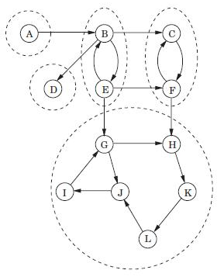
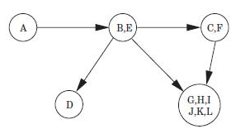
Strongly Connected Definition
SCC in Directed graph
The meta graph that shows we can “shrink” some nodes to just a node
A directed graph with its Strongly Connected Component

Slide 10
Tarjan’s SCC Algorithm
Introduction
Published in 1972 by Robert Tarjan, it was one of the first algorithms to be developed for finding SCCs in directed graphs
Tarjan's Algorithm is based on the concept of a depth-first search (DFS) of a directed graph.
The algorithm works by traversing the graph in a DFS manner, and keeping track of the nodes visited, the order in which they were visited, and the low-link values of each node.
The low-link value of a node is the smallest node number reachable from that node in the DFS traversal.
The time complexity is O(V+E)

Slide 11
Tarjan’s SCC Algorithm
Key Idea
Key idea: Nodes that are in the same SCC will have the same low-link value.
Therefore, SCCs can be identified by looking for groups of nodes that have the same low-link value.
Tarjan's Algorithm uses a stack to keep track of the nodes in each SCC as they are identified.

Slide 12
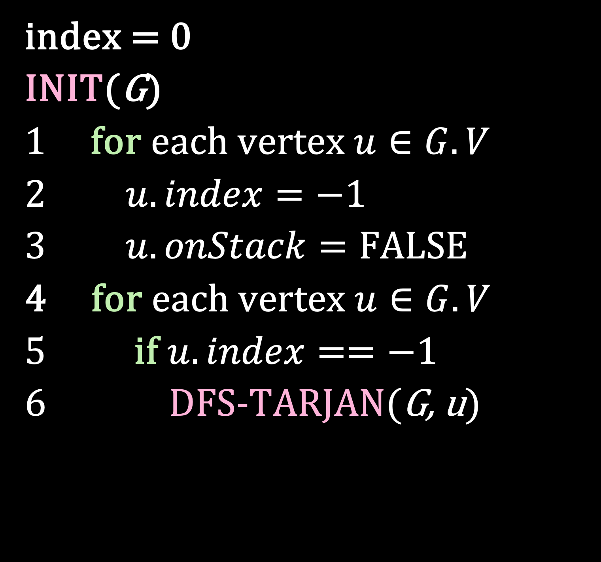
Tarjan’s SCC Algorithm
Tarjan DFS Procedure
index = 0
INIT(G)
1 for each vertex $u∈G.V$
2 $u.index=−1$
3 $u.onStack=FALSE$
4 for each vertex $u∈G.V$
5 if $u.index==−1$
6 DFS-TARJAN(G, u)

Slide 13
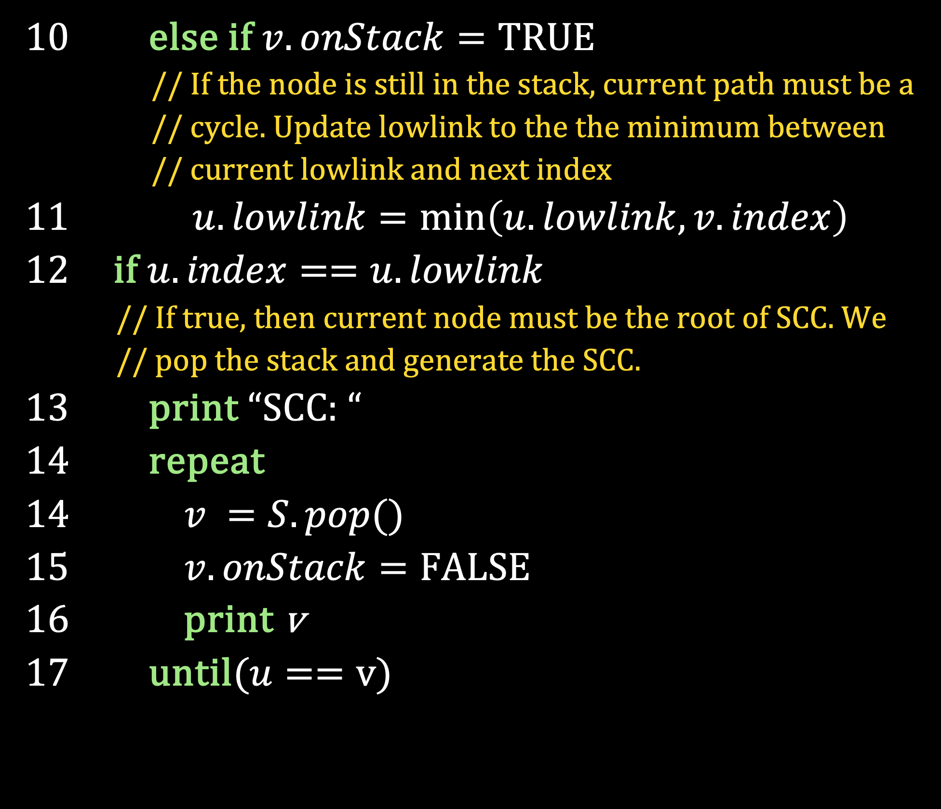
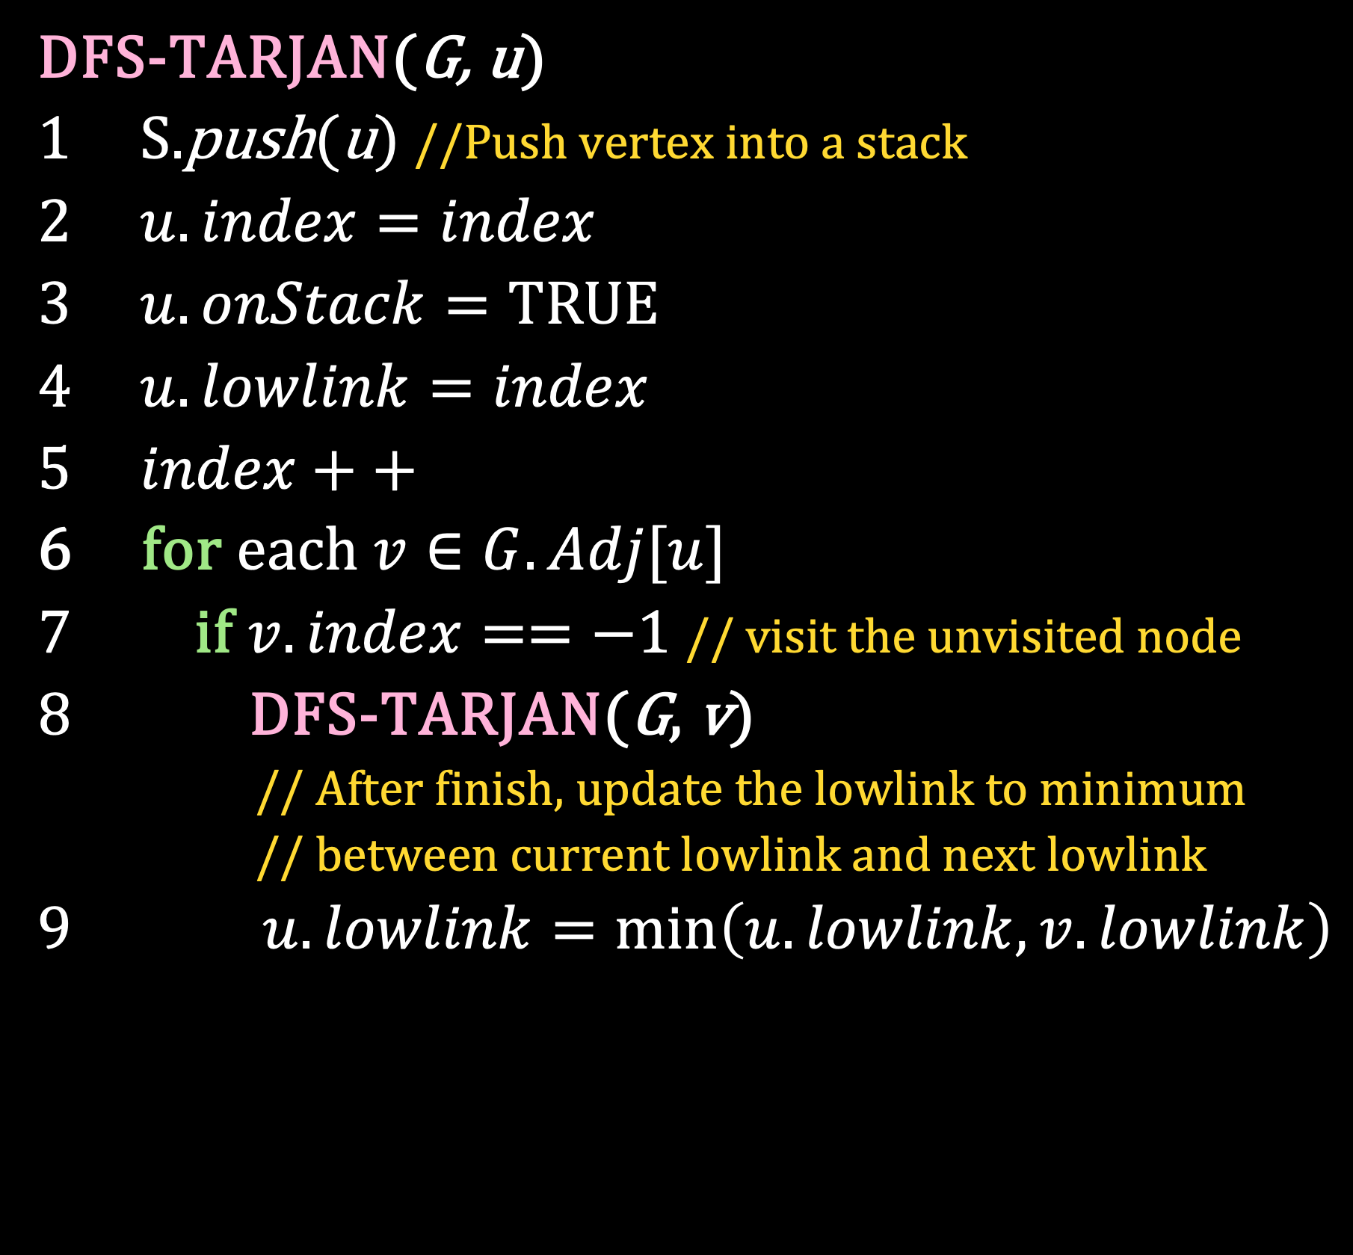
Tarjan’s SCC Algorithm
Tarjan DFS Procedure
DFS-TARJAN(G, u)
1 S.push(u) //Push vertex into a stack
2 $u.index=index$
3 $u.onStack=TRUE$
4 $u.lowlink=index$
5 $index++$
6 for each $v∈G.Adj[u]$
7 if $v.index==−1$ // visit the unvisited node
8 DFS-TARJAN(G, v)
// After finish, update the lowlink to minimum
// between current lowlink and next lowlink
9 $u.lowlink=\min\left(u.lowlink, v.lowlink\right)$
10 else if $v.onStack=TRUE$
// If the node is still in the stack, current path must be a
// cycle. Update lowlink to the the minimum between
// current lowlink and next index
11 $u.lowlink=\min\left(u.lowlink, v.index\right)$
12 if $u.index==u.lowlink$
// If true, then current node must be the root of SCC. We
// pop the stack and generate the SCC.
13 print “SCC: “
14 repeat
14 $v =S.pop()$
15 $v.onStack=FALSE$
16 print v
17 until($u==v$)

Slide 14
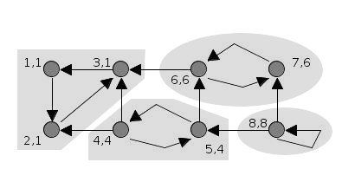
Tarjan’s SCC Algorithm
Simulation

Slide 15
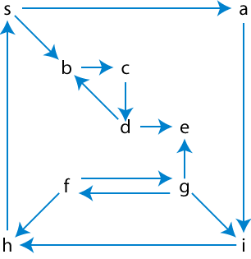
Exercises
19
Find the Strongly Connected Components using Tarjan’s SCC Algorithm

Slide 16
References
Thomas H. Cormen. (2022). Introduction to algorithms: Fourth edition. The MIT Press. Chapter 20.
https://stackdiary.com/glossary/tarjans-algorithm/
https://www.baeldung.com/cs/depth-first-search-intro

Slide 17
Thank you
GRAPH: SCC
September, 2023

